Slide 1
DISCRETE MATHEMATICAL STRUCTURES
UNIT I
Combinations with repetition

Slide 2
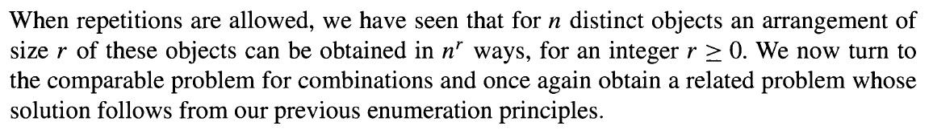
Combinations with repetition

Slide 3
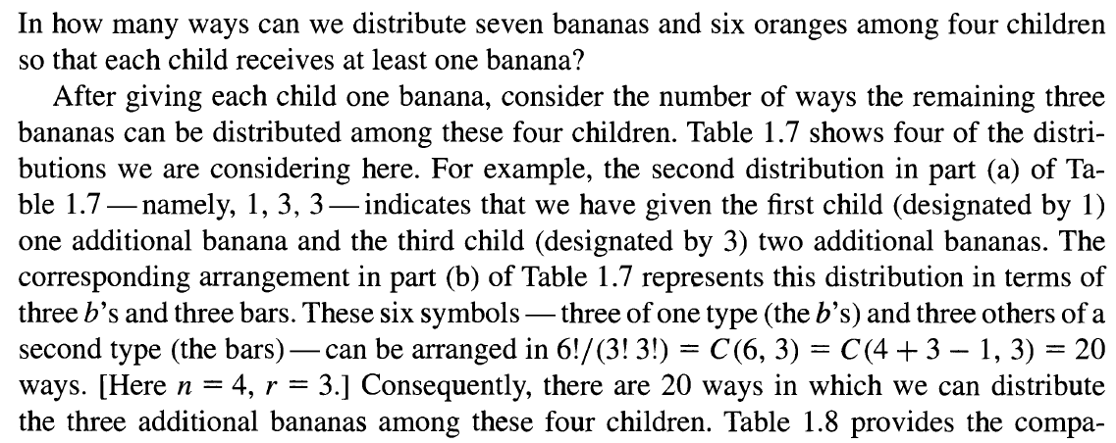
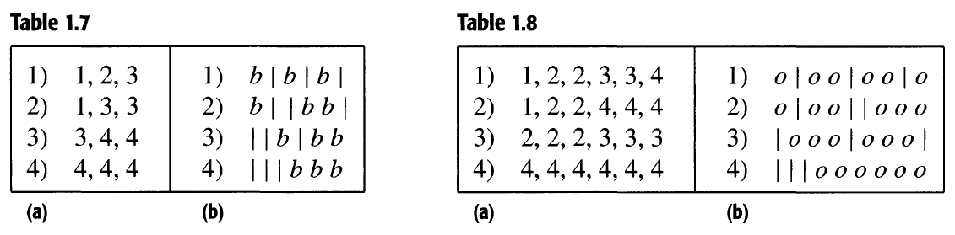
Combinations with repetition

Slide 4
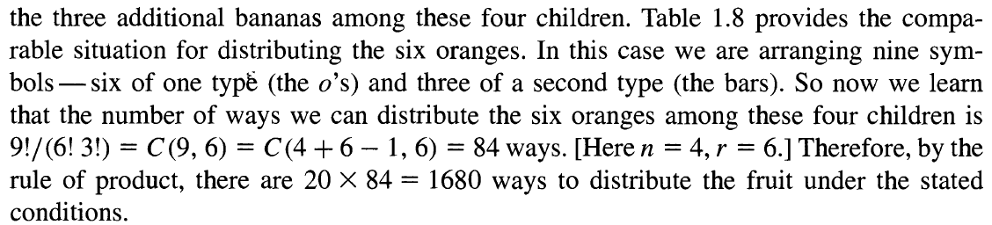
Combinations with repetition

Slide 5
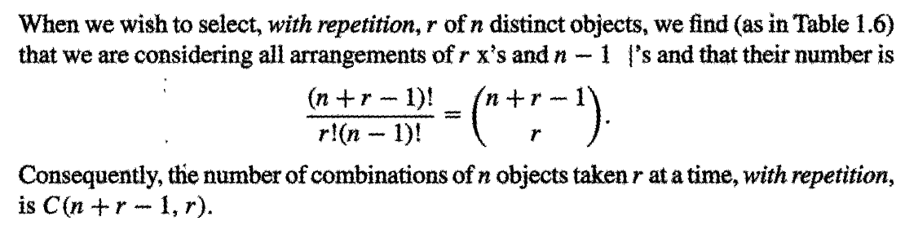
Combinations with repetition

Slide 6
Combinations with repetition
A donut shop offers 20 kinds of donuts. In how many ways a dozen donuts be selected ?

Slide 7
Combinations with repetition
A donut shop offers 20 kinds of donuts. In how many ways a dozen donuts be selected ?
n=20, r =12
C(n+r-1,r)
C(20+12-1,12) = C(31,12) = 14,11,20,525

Slide 8
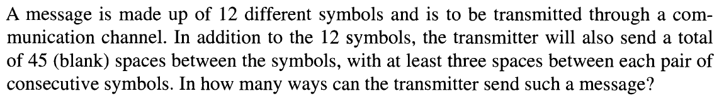
Combinations with repetition

Slide 9
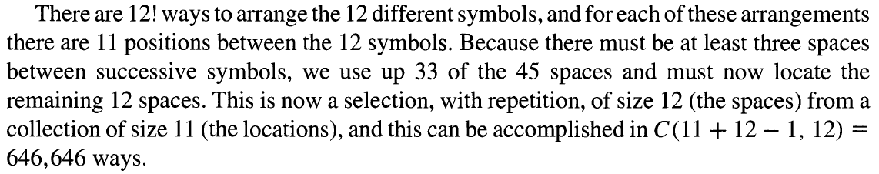
Combinations with repetition

Slide 10
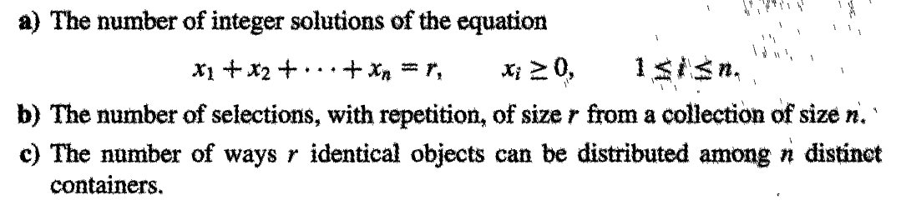
Combinations with repetition

Slide 11
Combinations with repetition
Distribute $1000 to 4 persons (in unit of $100)
no restriction (b) at least $100 for anyone
(c) at least $100 for anyone, Sam has at least $500

Slide 12
Combinations with repetition
Distribute $1000 to 4 persons (in unit of $100)
no restriction (b) at least $100 for anyone
(c) at least $100 for anyone, Sam has at least $500
(a) (b)
(c )

Slide 13
Combinations with repetition
How many terms there are in the expansion of

Slide 14
Combinations with repetition
How many terms there are in the expansion of
Where 0 ≤ ni, for 1 ≤i ≤4 and
Therefore, C(4+10-1,10)=286
Each distinct term is of the form

Slide 15
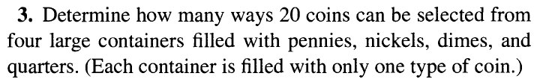
Combinations with repetition

Slide 16

Combinations with repetition

Slide 17
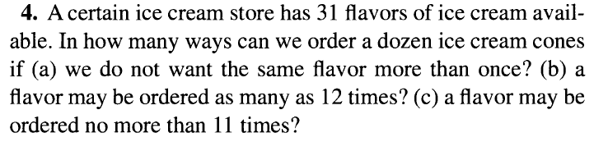
Combinations with repetition

Slide 18
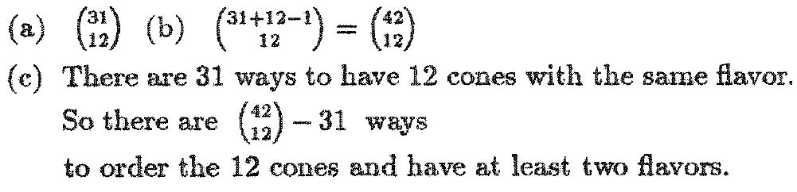
Combinations with repetition

Slide 19
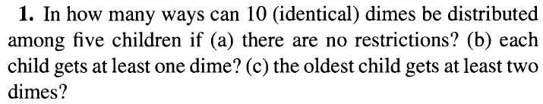
Combinations with repetition

Slide 20
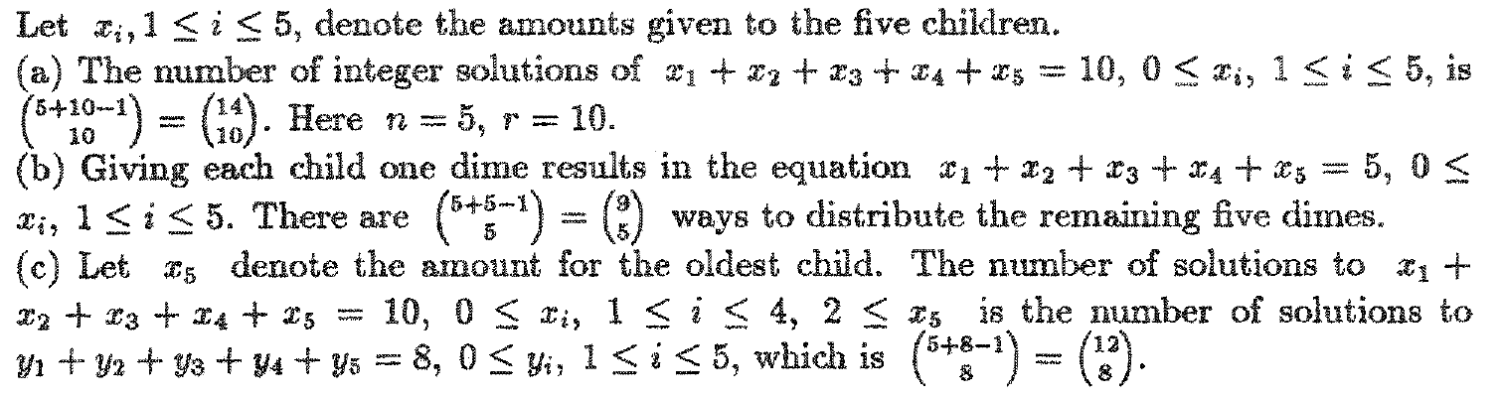
Combinations with repetition

Slide 21
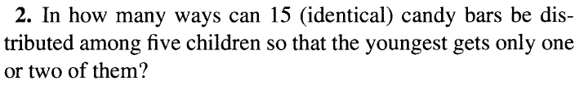
Combinations with repetition

Slide 22
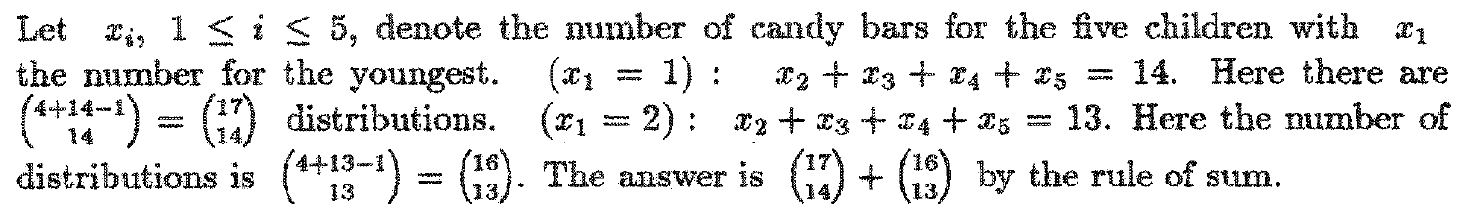
Combinations with repetition

Slide 23
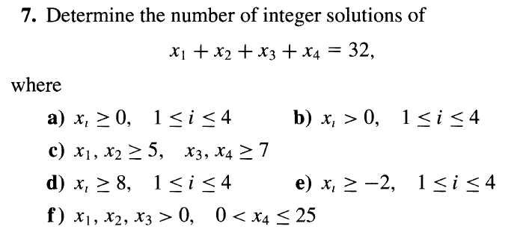
Combinations with repetition

Slide 24
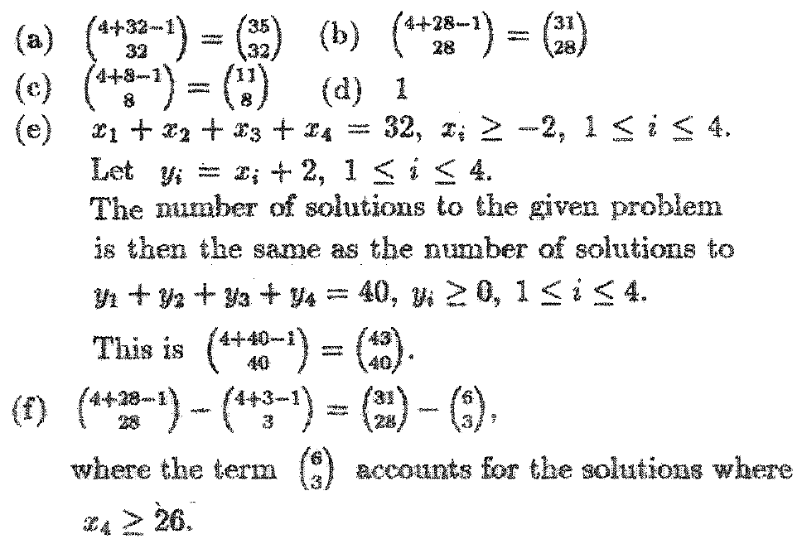
Combinations with repetition

Slide 25
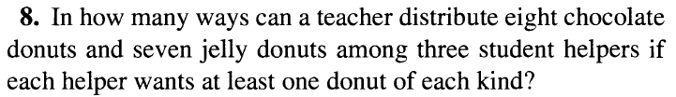
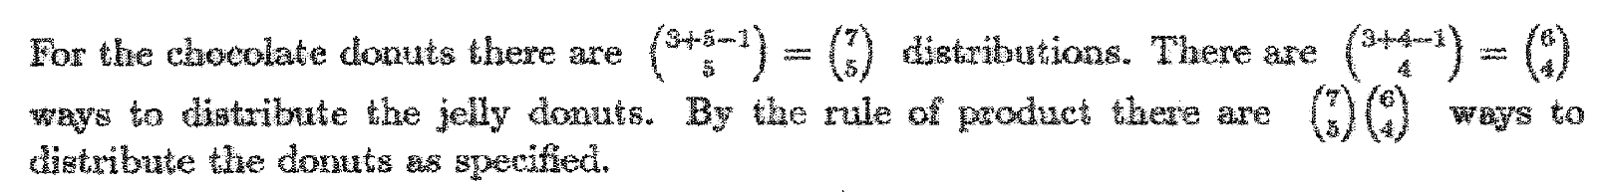
Combinations with repetition

Slide 26
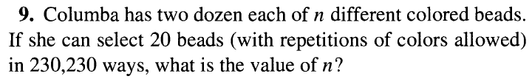
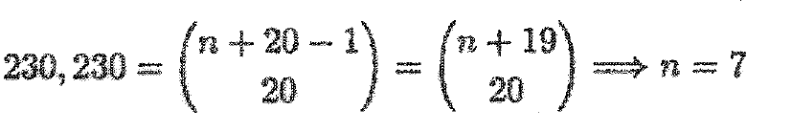
Combinations with repetition

Slide 27
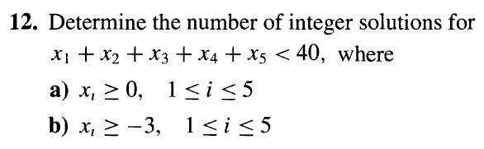
Combinations with repetition

Slide 28
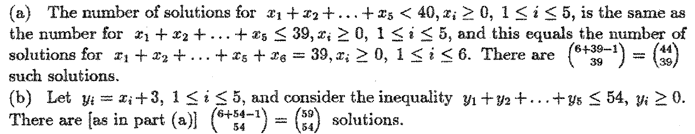
Combinations with repetition

Slide 29
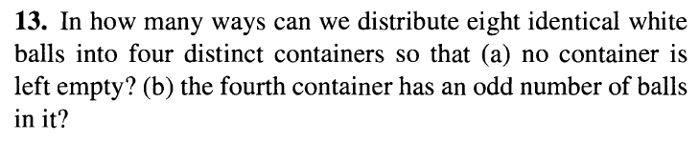
Combinations with repetition

Slide 30
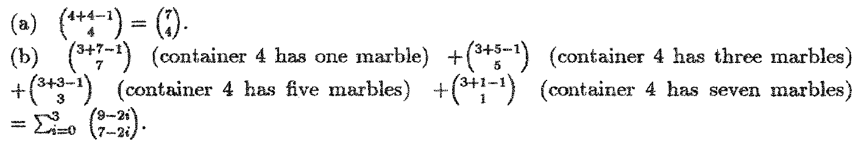
Combinations with repetition

Slide 31
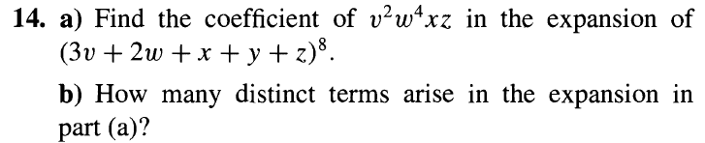
Combinations with repetition

Slide 32
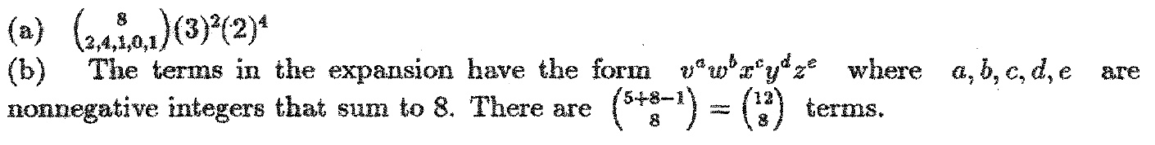
Combinations with repetition

